Slide 1




Ethereum Blockchain & Smart Contracts
Presented By :
P.Thaslin
1st year
B.tech-AI&DS
SVCT Blockchain Club

Slide 2
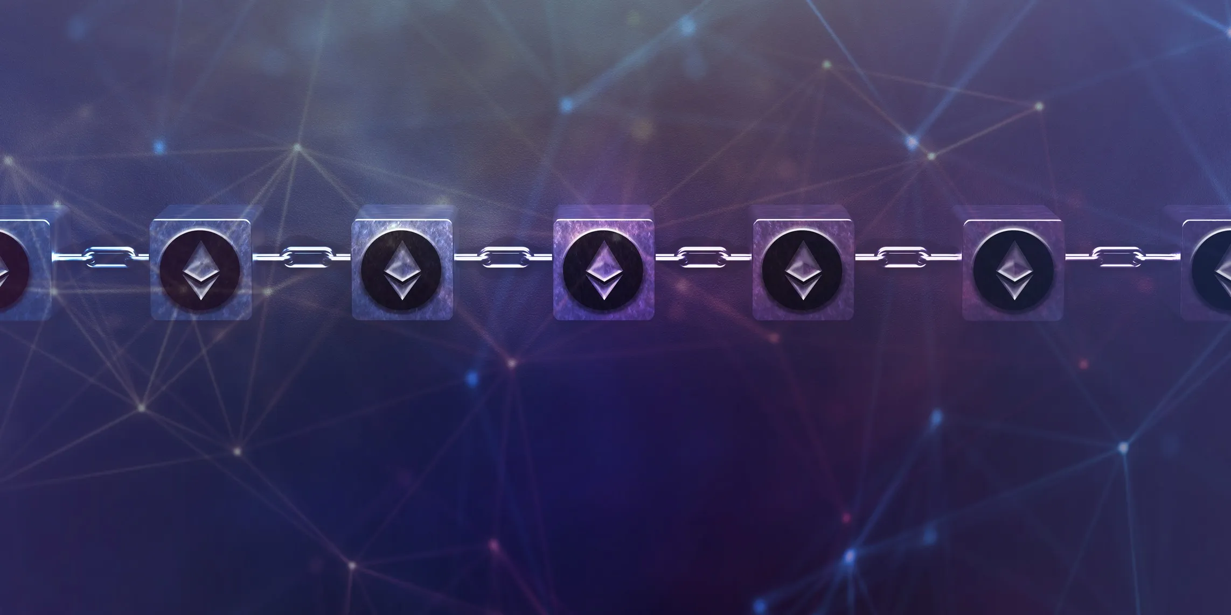
Topics :
Ethereum Overview
Ethereum Virtual Machine
Gas-smart Contract & Fees
Structure & Solidity Features

Slide 3
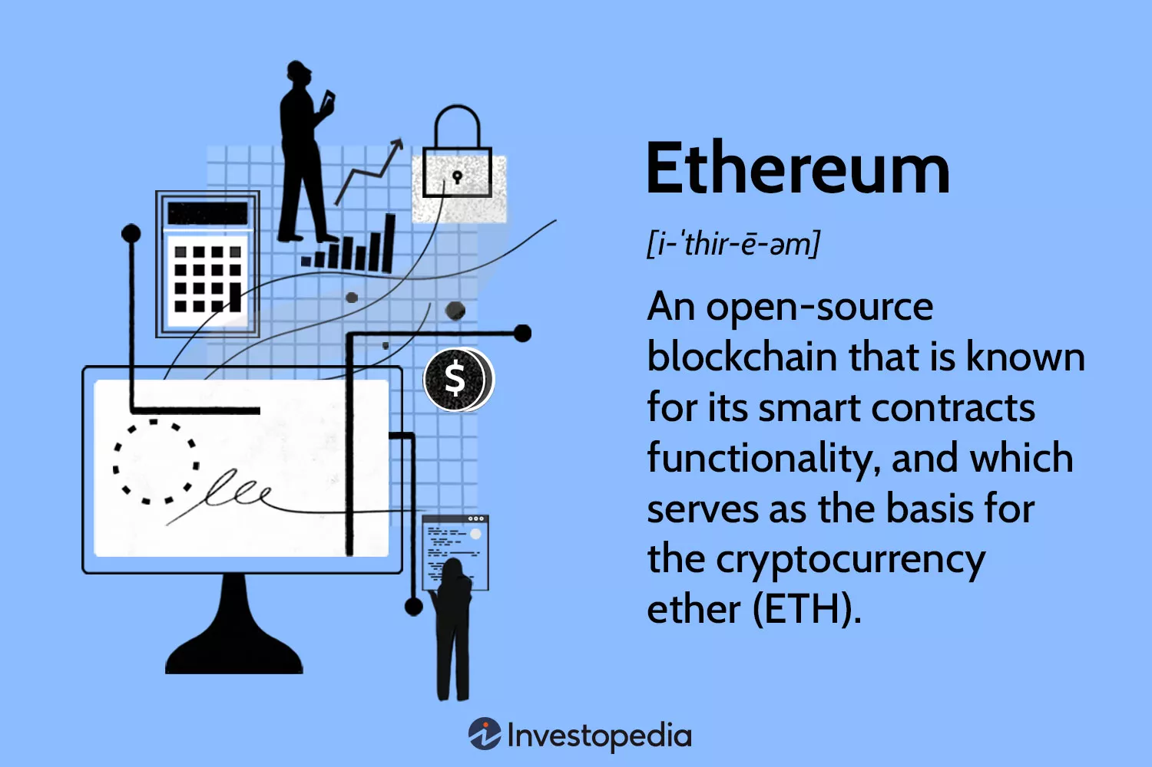

Slide 4
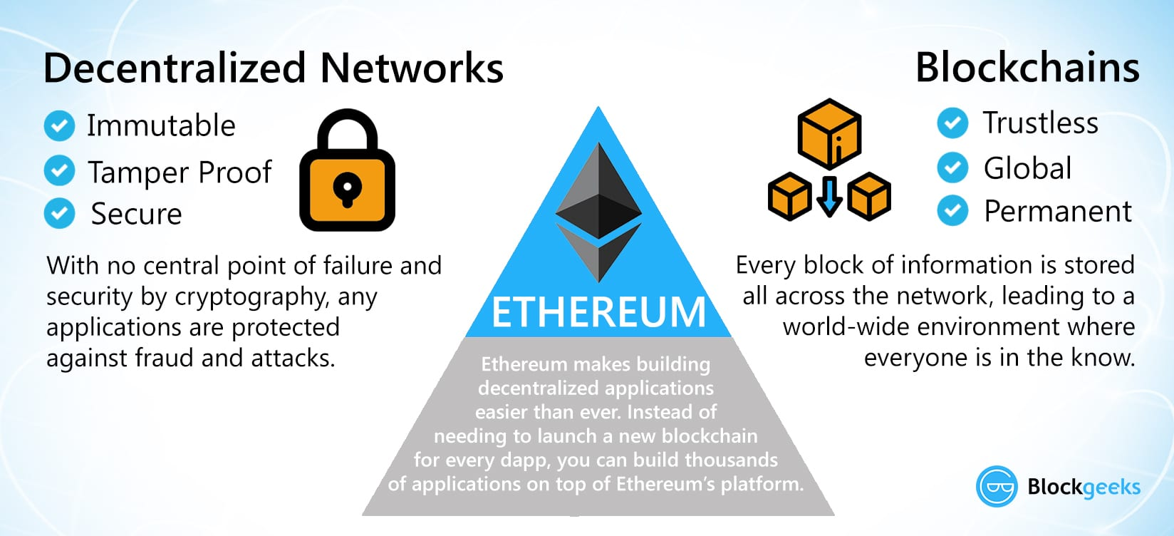

Slide 5
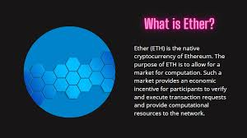

Slide 6
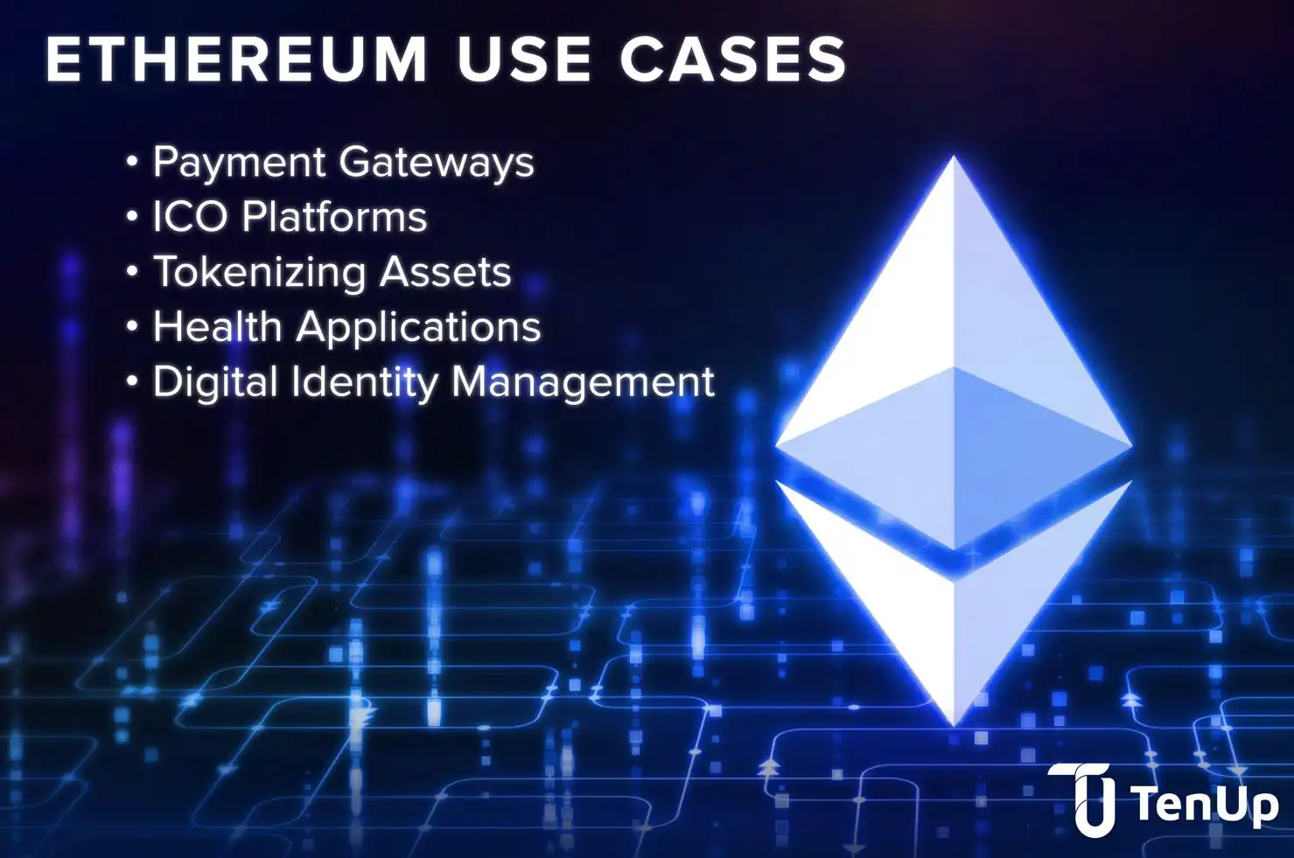

Slide 7
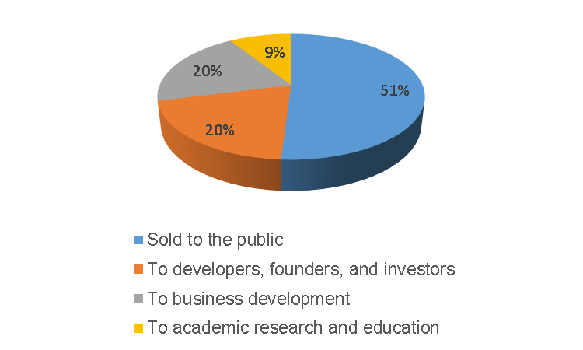

Slide 8
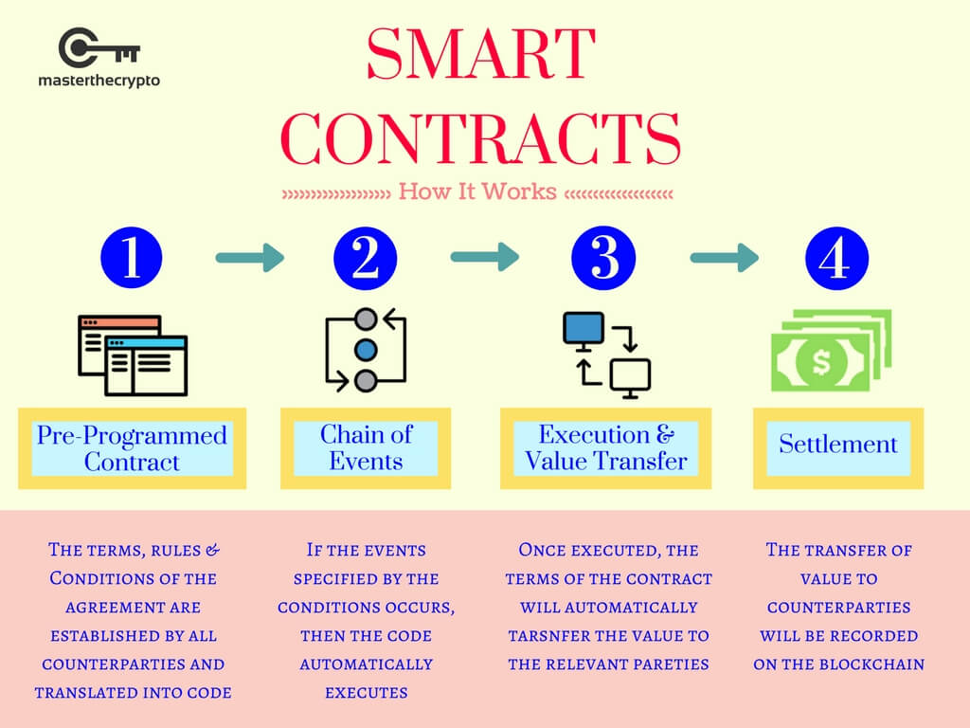

Slide 9
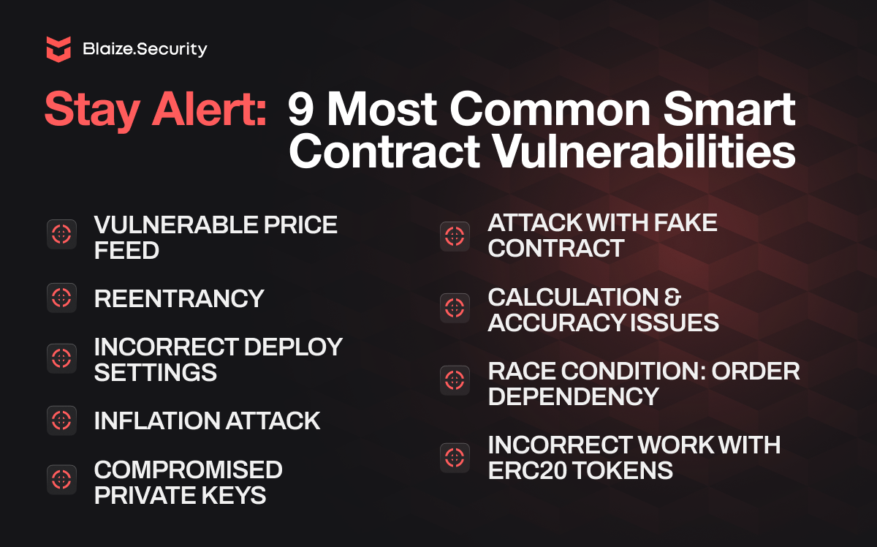

Slide 10


Slide 11
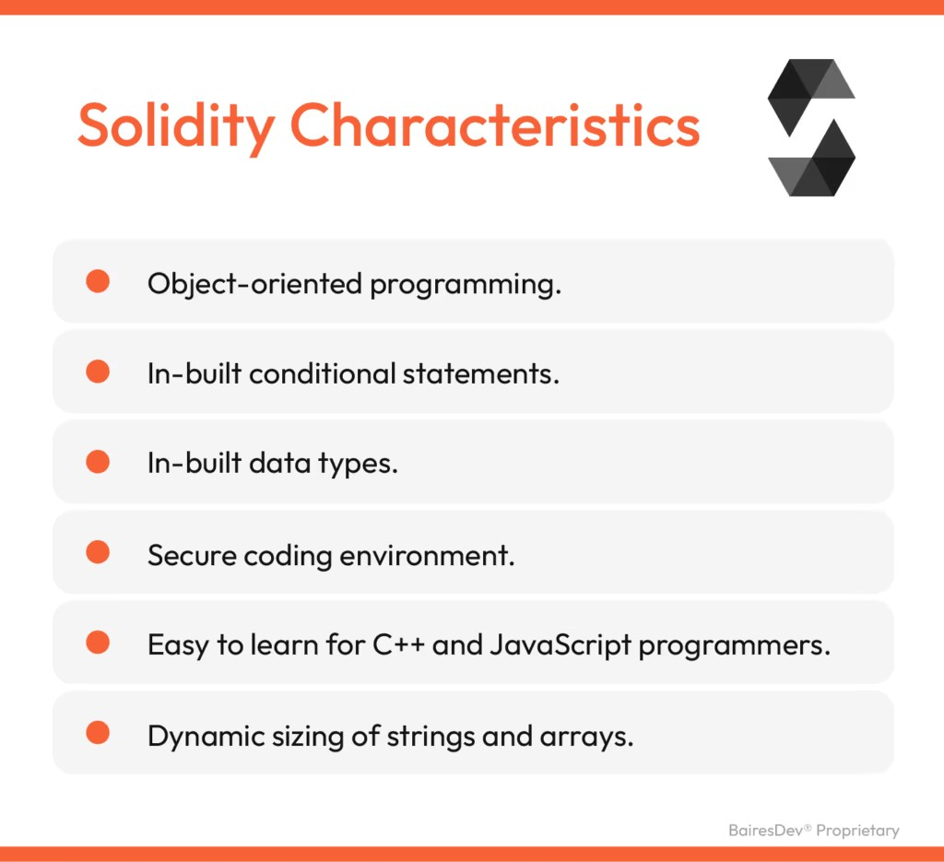

Slide 12
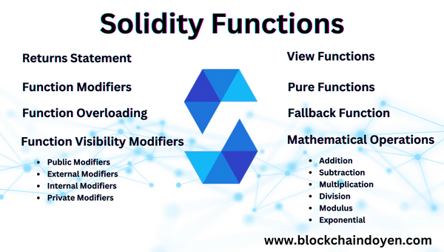

Slide 13


Slide 14
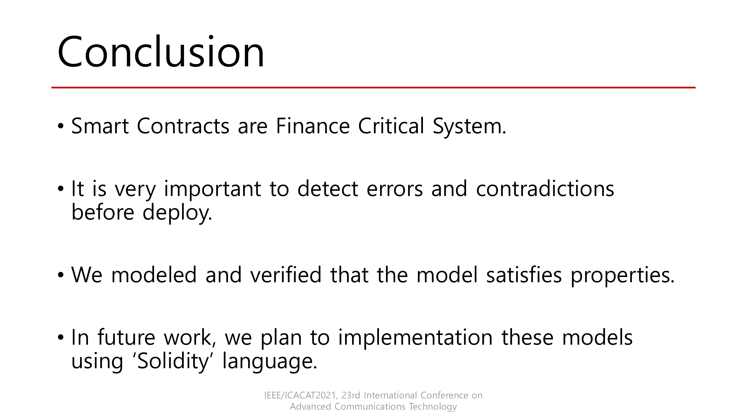

Slide 15
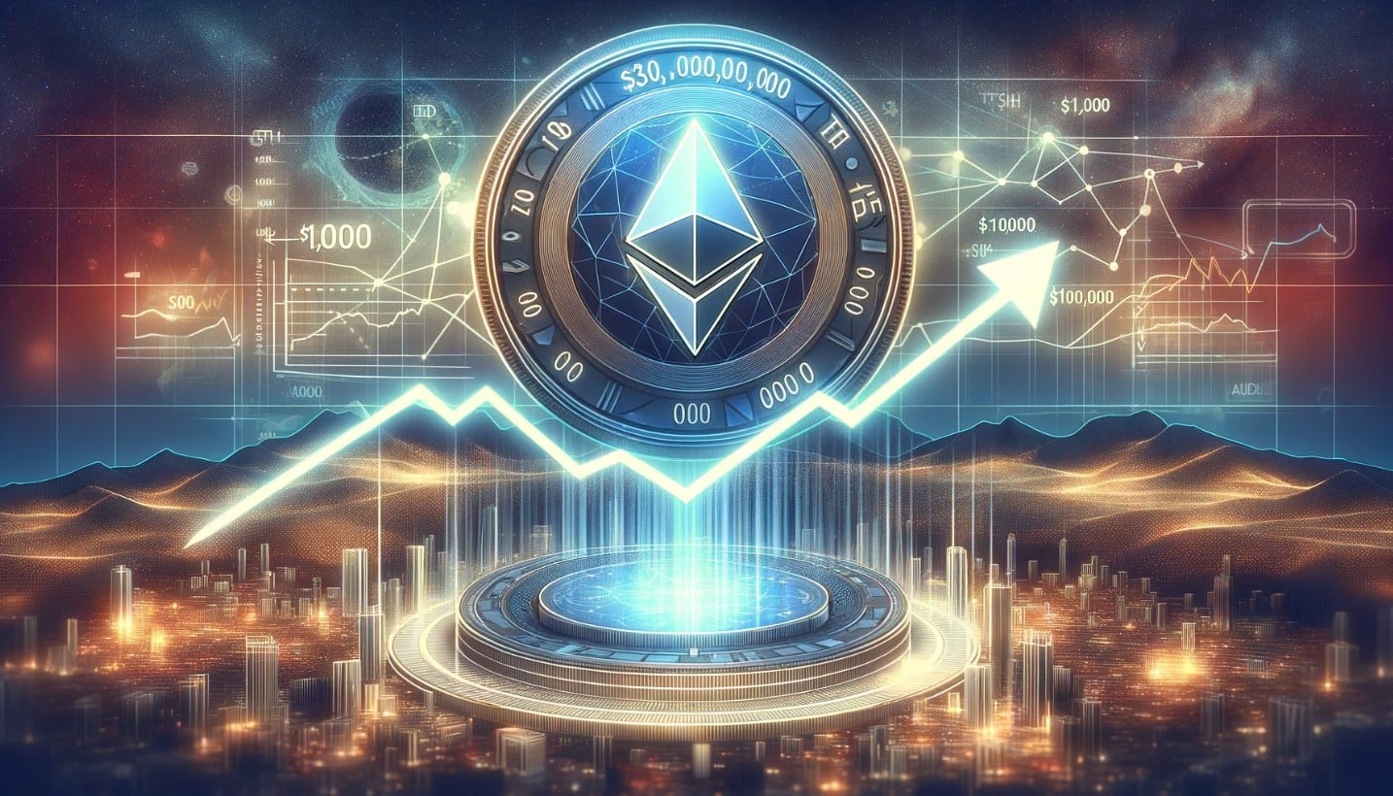
THANK YOU ALL..!!!
Presented By:
P.Thaslin
1st Year B.Tech
Dept:AI&DS
SVCT Blockchain Club

